Slide 1
C++
Dr. Zahid Halim

Slide 2
History of C and C++
C++ evolved from C
  C evolved from two other programming languages, BCPL(Basic Combined Programming Language) and B
ANSI C
  Established worldwide standards for C programming
C++
  Provides capabilities for object-oriented programming
    Objects are reusable software components that model things in the real world
    Object-oriented programs are easy to understand, correct and modify

Slide 3
C++ Standard Library
C++ programs
  Built from pieces called classes and functions
C++ standard library
  Provides rich collections of existing classes and functions for all programmers to use

Slide 4
Other High-level Languages
Other high-level languages
  FORTRAN
    Used in scientific and engineering applications
  COBOL
    Used to manipulate large amounts of data
  Pascal
    Used to teach structured programming

Slide 5
Structured Programming
Structured programming
  Disciplined approach to writing programs
  Clear, easy to test and debug, and easy to modify
Multitasking
  Many activities to run in parallel

Slide 6
Basics of a Typical C++ Environment
Phases of C++ Programs:
  Edit
  Preprocess
  Compile
  Link
  Load
  Execute
Editor
Program is created in
the editor and stored
on disk.
Disk
Preprocessor
Disk
Preprocessor program
processes the code.
Compiler
Compiler creates
object code and stores
it on disk.
Disk
Linker links the object
code with the libraries,
creates a.out and
stores it on disk
Linker
Disk
Primary
Memory
Loader
Loader puts program
in memory.
Disk
.
.
.
.
.
.
Primary
Memory
CPU
CPU takes each
instruction and
executes it, possibly
storing new data
values as the program
executes.
.
.
.
.
.
.

Slide 7
Introduction to C++ Programming
C++ language
  Facilitates a structured and disciplined approach to computer program design
Following are several examples
  The examples illustrate many important features of C++
  Each example is analyzed one statement at a time.

Slide 8
1 // Fig. 1.2: fig01_02.cpp
2 // A first program in C++
Comments
Written between /* and */ or following a //.
Improve program readability and do not cause the computer to perform any action.
3 #include <iostream>
4
5 int main()
6 {
preprocessor directive
Message to the C++ preprocessor.
Lines beginning with # are preprocessor directives.
#include <iostream> tells the preprocessor to include the contents of the file <iostream>, which includes input/output operations (such as printing to the screen).
7 std::cout << "Welcome to C++!\n";
8
9 return 0; // indicate that program ended successfully
10 }
C++ programs contain one or more functions, one of which must be main
Parenthesis are used to indicate a function
int means that main "returns" an integer value. More in Chapter 3.
Welcome to C++!
Prints the string of characters contained between the quotation marks.
The entire line, including std::cout, the << operator, the string "Welcome to C++!\n" and the semicolon (;), is called a statement.
All statements must end with a semicolon.
return is a way to exit a function from a function.
return 0, in this case, means that the program terminated normally.
A left brace { begins the body of every function and a right brace } ends it.

Slide 9
A Simple Program:
Printing a Line of Text
std::cout
  Standard output stream object
  “Connected” to the screen
  std:: specifies the "namespace" which cout belongs to
    std:: can be removed through the use of using statements
<<
  Stream insertion operator
  Value to the right of the operator (right operand) inserted into output stream (which is connected to the screen)
  std::cout << “Welcome to C++!\n”;
\
  Escape character
  Indicates that a “special” character is to be output

Slide 10
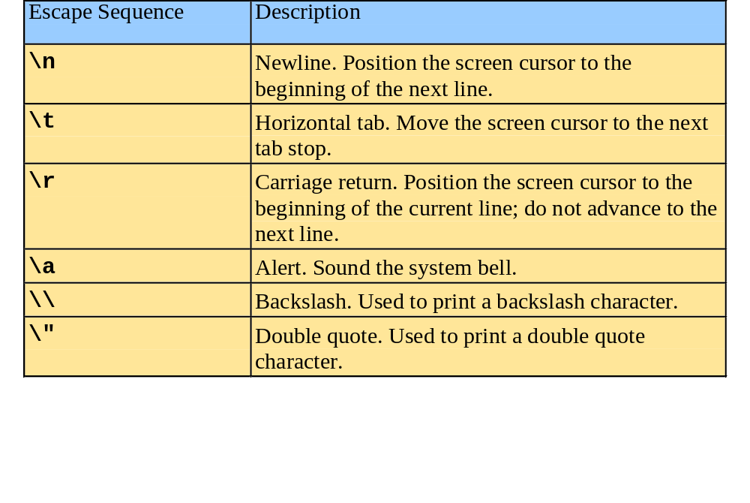
Simple Program:
Printing a Line of Text
There are multiple ways to print text
  Following are more examples

Slide 11
References
  Dietal and Dietal : How to Program C++
  3rd Edition

